Slide 1
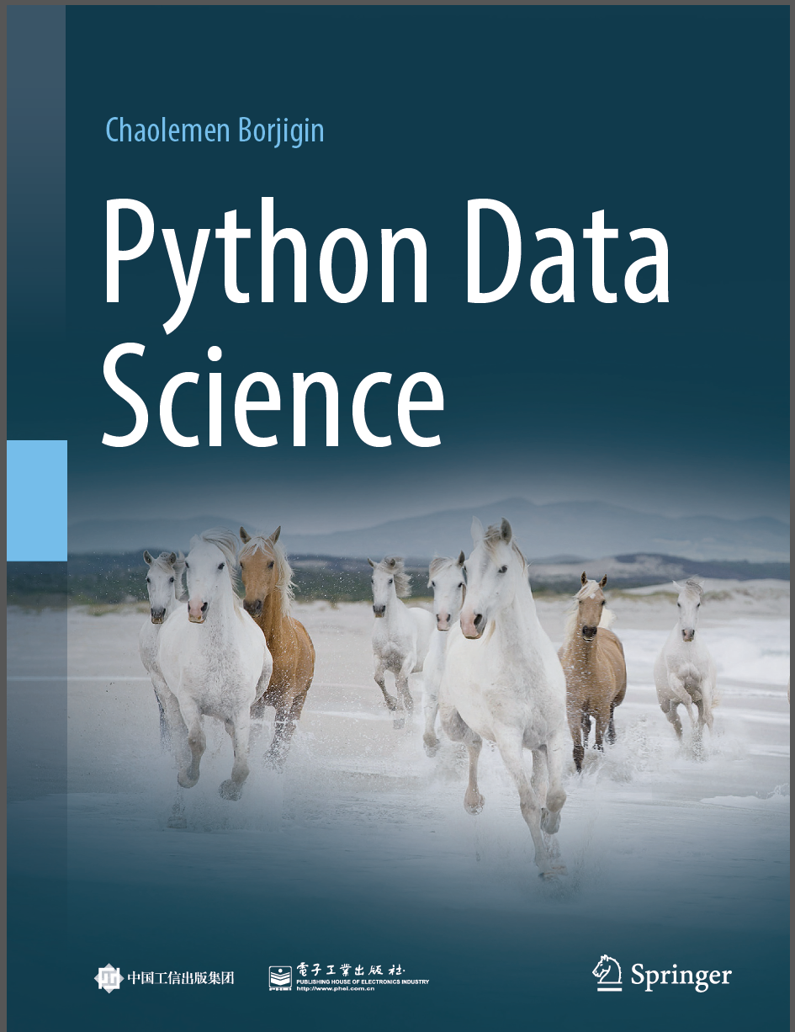
Python Data Science
Chaolemen Borjigin
Renmin University of China
chaolemen@ruc.edu.cn

Slide 2
3.4 Help documentation
▼ Chapter 3 Advanced Python Programming for Data Science
► 3.4 Help documentation
Chaolemen Borjigin
Renmin University of China
chaolemen@ruc.edu.cn

Slide 3
Summary of this chapter
▼ Chapter 3 Advanced Python Programming for Data Science
► 3.4 Help documentation
3.4.1 The help function
3.4.2 DocString
3.4.3 Checking source code
3.4.4 The doc attribute
3.4.5 The dir() function

Slide 4
3.4.1 The help function
▼Chapter 3 Advanced Python Programming for Data Science
► 3.4 Help documentation
In[1]:
help(len)
Help on built-in function len in module builtins:
len(obj, /)
Return the number of items in a container.

Slide 5
3.4.2 DocString
▼Chapter 3 Advanced Python Programming for Data Science
► 3.4 Help documentation
In[2]:
len?
#Signature: len(obj, /)
#Docstring: Return the number of items in a container.
#Type: builtin_function_or_method
In[3]:
myList1=[1,2,3,4]
myList1.append?
#Docstring: L.append(object) -> None -- append object to end
#Type: builtin_function_or_method

Slide 6
3.4.2 DocString
▼Chapter 3 Advanced Python Programming for Data Science
► 3.4 Help documentation
In[4]:
def testDocString():
"""This is docString,
You can use "?" to view the help information"""
return(1)
testDocString?
#Signature: testDocString()
#Docstring:
#This is docString,
#You can use "?" to view the help information
#File: c:\users\soloman\clm\<ipython-input-4-742d4bf944c4>
#Type: function
In[5]:
?testDocString

Slide 7
3.4.3 Checking source code
▼Chapter 3 Advanced Python Programming for Data Science
► 3.4 Help documentation
In[6]:
testDocString??
In[7]:
len?
#Signature: len(obj, /)
#Docstring: Return the number of items in a container.
#Type: builtin_function_or_method
In[8]:
len??)

Slide 8
3.4.4 The doc attribute
▼Chapter 3 Advanced Python Programming for Data Science
► 3.4 Help documentation
In[9]:
testDocString.__doc__
Out[9]:
'This is docString,\n You can use "?" to view the help information'
In[10]:
len.__doc__
Out[10]:
'Return the number of items in a container.'

Slide 9
3.4.5 The dir() function
▼Chapter 3 Advanced Python Programming for Data Science
► 3.4 Help documentation
In[11]:
dir(print)
Out[11]:
['__call__',
'__class__',
'__delattr__',
'__dir__',
'__doc__',
……
'__str__',
'__subclasshook__',
'__text_signature__']

Slide 10
3.4.5 The dir() function
▼Chapter 3 Advanced Python Programming for Data Science
► 3.4 Help documentation
In[12]:
dir(len)
Out[12]:
['__call__',
'__class__',
'__delattr__',
……
'__subclasshook__',
'__text_signature__']
In[13]:
dir?

Slide 11


